Slide 1
Animation
Animate the pencil to "underline" Animation.
With PhotoShop & PowerPoint

Slide 2

1 Class work Photoshop – Switch Objects
To switch between two similar but different objects
to give the illusion of "movement."

Slide 3

1 Project Photoshop – Switch Objects
To switch between two similar but different objects
to give the illusion of "movement."

Slide 4

2 Class work Photoshop – Change 3 colors
To change colors on objects--at least 3 color changes.

Slide 5
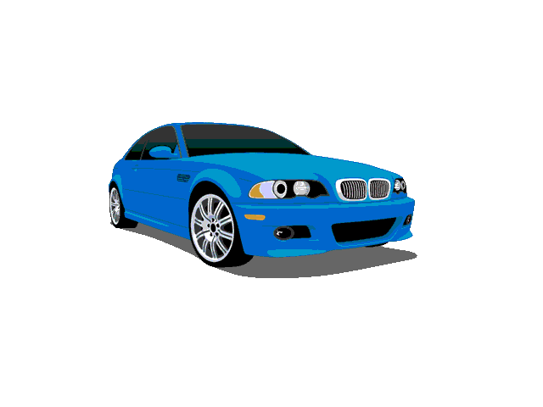
2 Project Photoshop – Change 3 colors
To change colors on objects--at least 3 color changes.

Slide 6

3 Class work Photoshop - Movement
To animate object--bouncing, dancing, flying, etc.

Slide 7

3 Project Photoshop - Movement
To animate object--bouncing, dancing, flying, etc.

Slide 8

4 Class work Photoshop – Spell Text
To animate text--cycle among 3 words, spell letter by letter, etc.

Slide 9

4 Project Photoshop – Spell Text
To animate text--cycle among 3 words, spell letter by letter, etc.

Slide 10

5 Class work Photoshop - Explosion
To "explode" your first name.

Slide 11

5 Project Photoshop - Explosion
To "explode" your first name.

Slide 12

6 Class work Photoshop-
Animated Slogan using 3 Layers
Like Nike's "Just do it"!
Must include a picture of the product
and words of slogan.

Slide 13

6 Project Photoshop -
Animated Slogan using 3 Layers

Slide 14
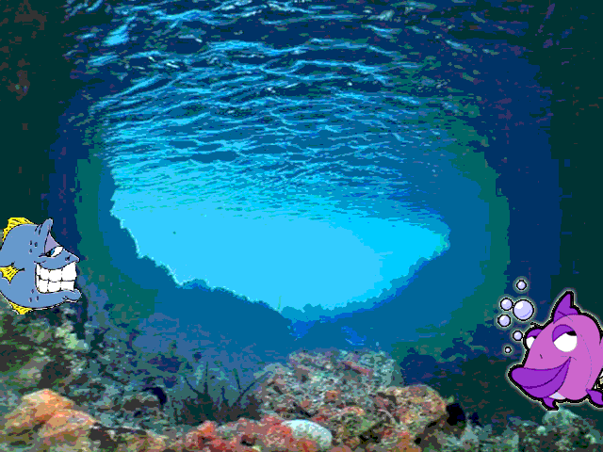
7 Class work PS - Timeline Animation

Slide 15
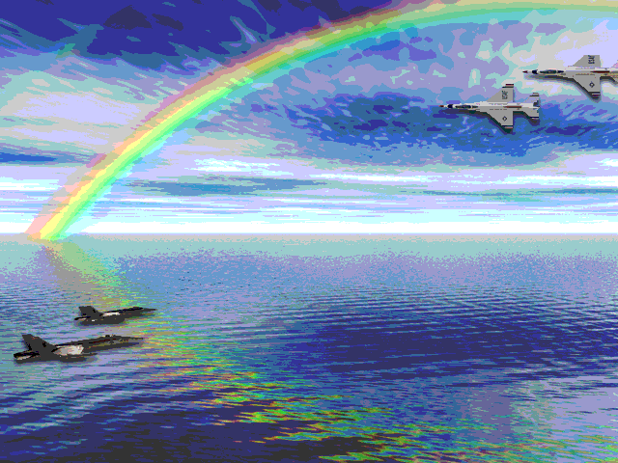
7 Project PS - Timeline Animation

Slide 16


8 Class work PPT - Motion Paths

Slide 17


8 Project PPT - Motion Paths

Slide 18

9 Class work - Animated .Gifs in PPT
Search for keyword "people"
Search in "all collections"
Results should be "movies" only

Slide 19

9 Project - Animated .Gifs in PPT
Search for keyword "people"
Search in "all collections"
Results should be "movies" only

Slide 20


10 Class work – PPT - Add Transparency
Make the white square transparent on the right.

Slide 21
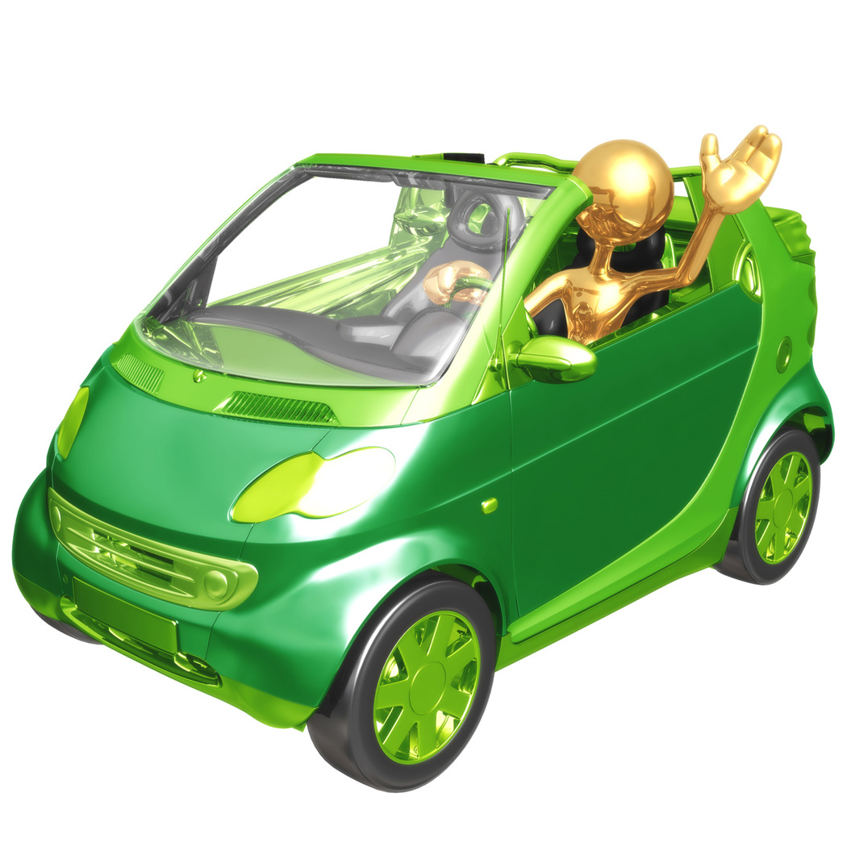
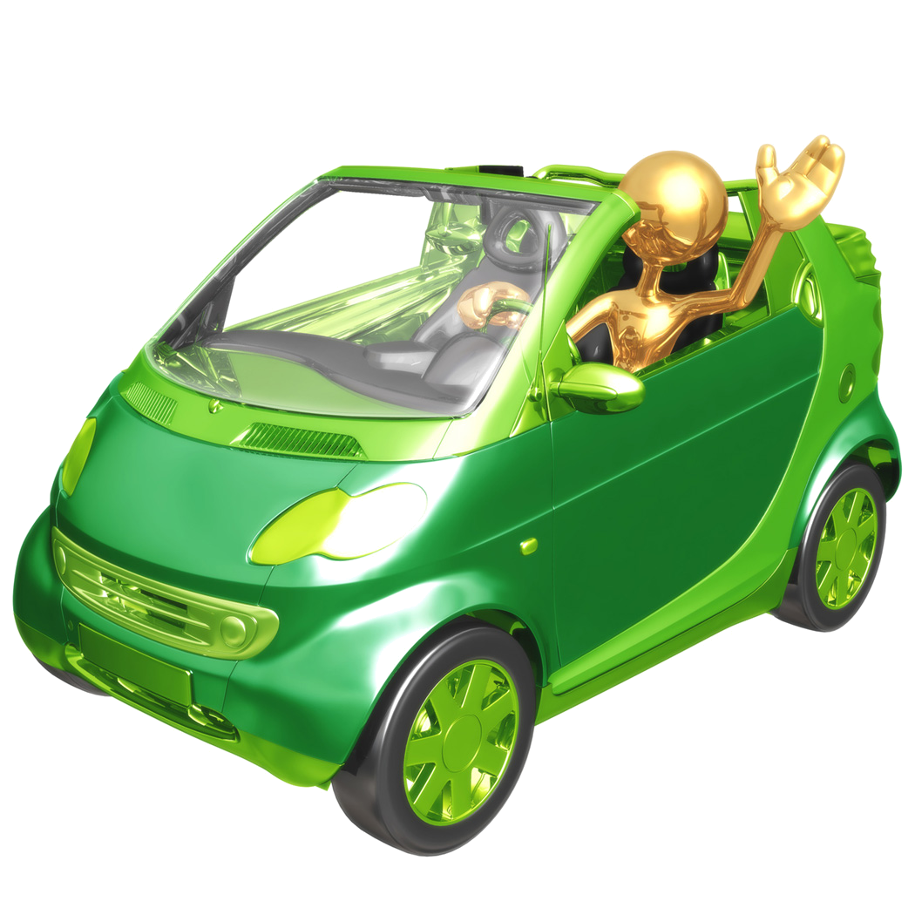
10 Project – PPT - Add Transparency
Find a new clipart with a "white background" -
make the white square transparent
on the 2nd copy of the clipart.

Slide 22
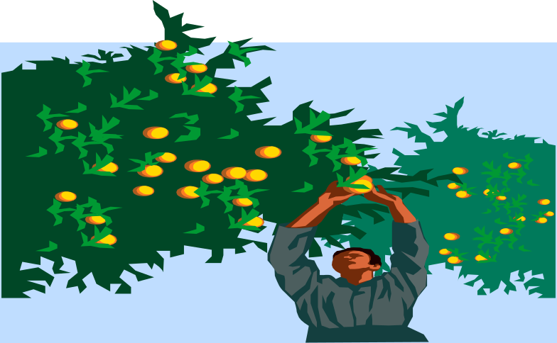
11 Class work - Use PPT to Change Colors
Use the "recolor" feature to make the blue sky orange.

Slide 23

11 Project - Use PPT to Change Colors on a new picture.
Use the "recolor" feature to change colors.
Show the before & after.

Slide 24
Hope you had fun!

